Slide 1
Data Visualization & Interpretation
Febin.A.Vahab

Slide 2
RECAP

Slide 3
Data Viz-Definition,Objectives.
Visualisation as a discovery tool(Anscombe’s Quartet)
Visualisation Objectives

Slide 4

Car Manufacturer
DressMart Inc.
Article from NewYork Times

Slide 5
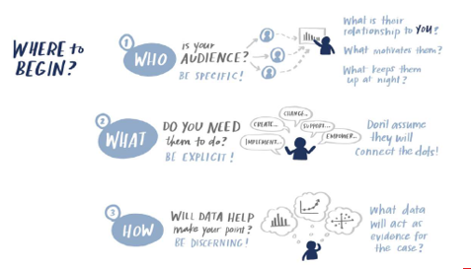
Visualisation Context
CASE Study
Summer Learning Programme
Clothing Retailer
DSE Electives
CANVAS
Higher Education
People Analyst

Slide 6
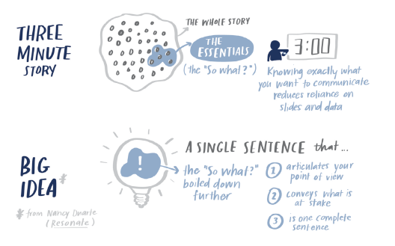

Slide 7
SESSION 3 -PLAN
Choosing an effective Visual
Gestalt Principles of Visual Perception
Notes:
The representation and presentation of data that exploits our visual perception abilities in order to amplify cognition

Slide 8
Taxonomy of Data Visualisation Methods
Comparing categorical values
Assessing hierarchies and part-of-a-whole relationships
Showing changes over time
Plotting connections and relationships
Mapping geo-spatial data

Slide 9
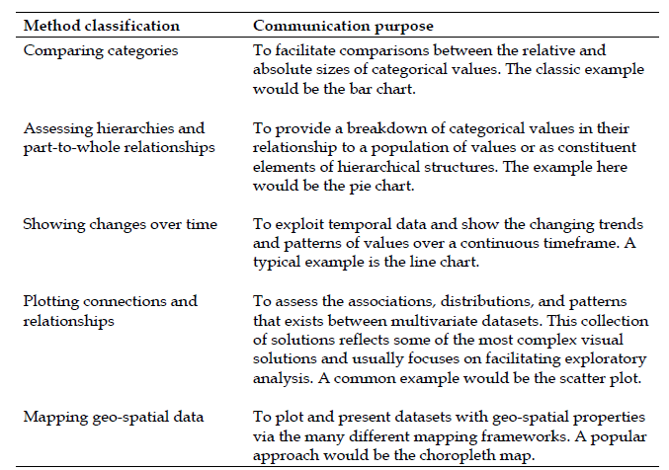
Primary communication purpose of each method
classification

Slide 12
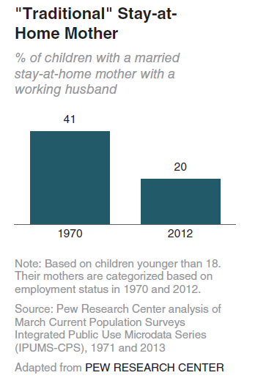
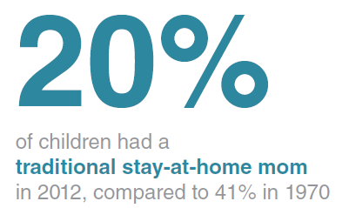
Textuals
Page Views:
10,267

Slide 13
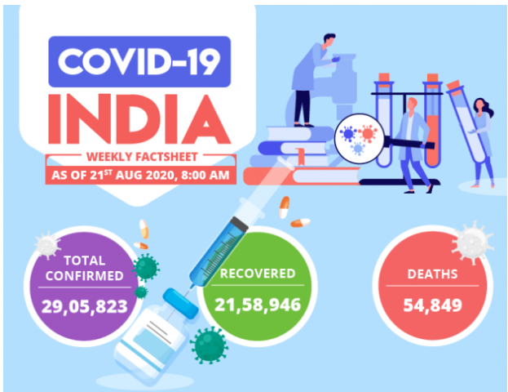
Textuals

Slide 14
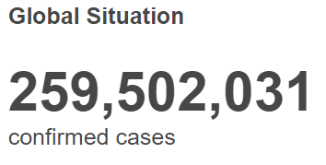
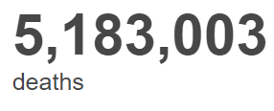
WHO statistics as per 24th November,2021

Slide 15
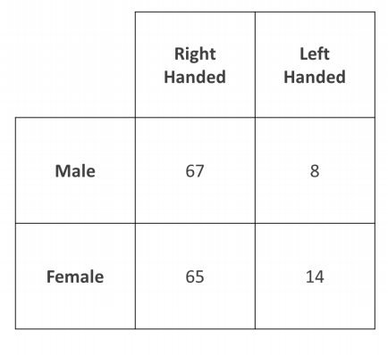
Tables

Slide 16
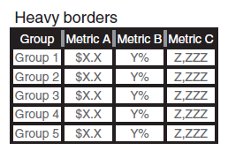
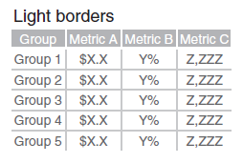
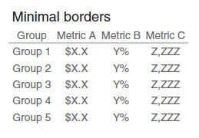
Tables

Slide 17
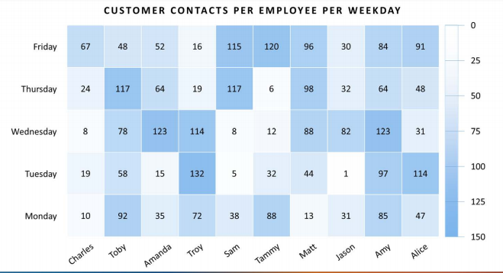
Heat Maps

Slide 18
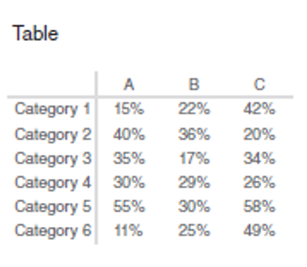
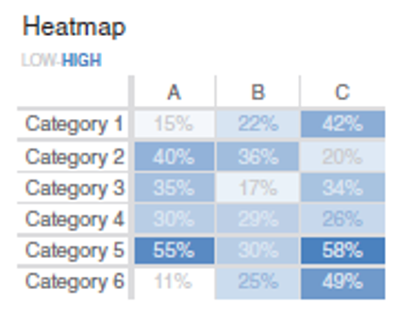
HeatMaps

Slide 19
GRAPHS
Graphs interact with our visual system
Faster at processing information
Points, lines, bars, and area

Slide 20
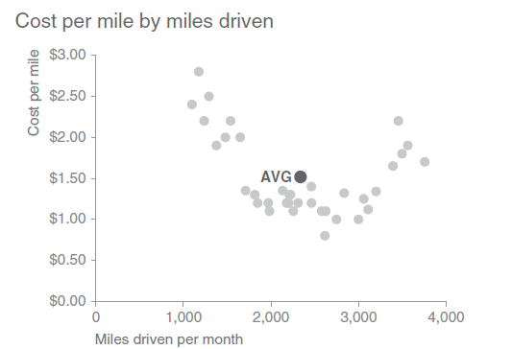
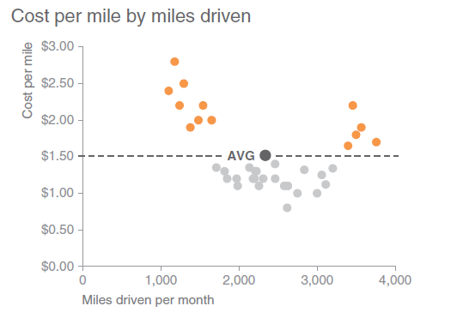
Scatterplot

Slide 21
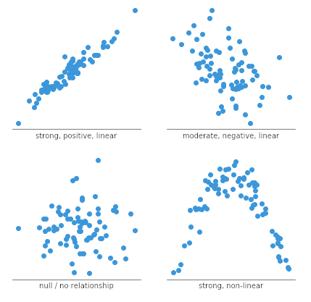
Scatterplot

Slide 22
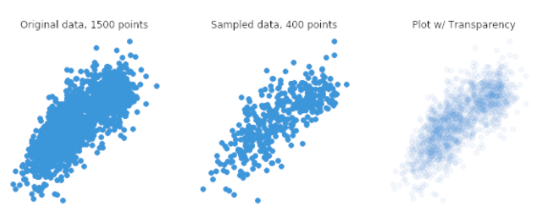

Scatterplot

Slide 23
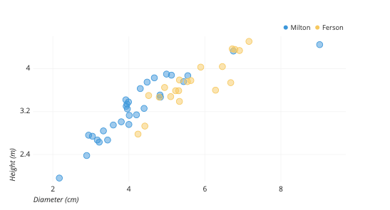

Scatterplot

Slide 24
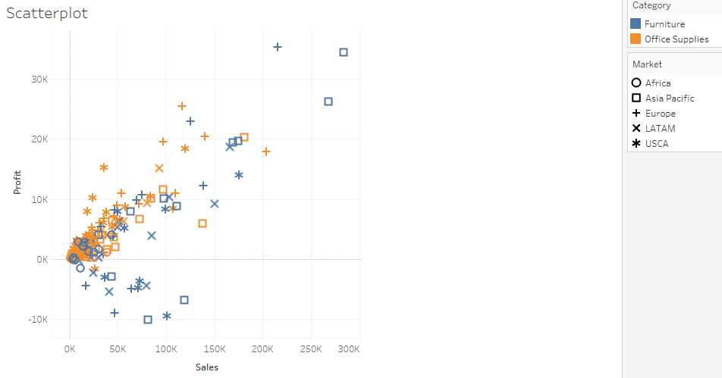
Scatterplot

Slide 25
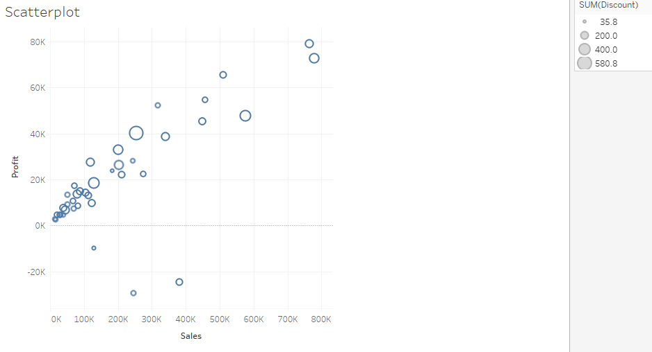
Scatter Plot

Slide 26
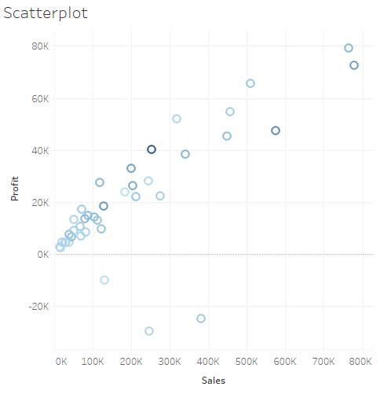
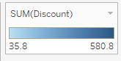
Scatterplot

Slide 27
Exercise-Bubble Plot

Slide 28
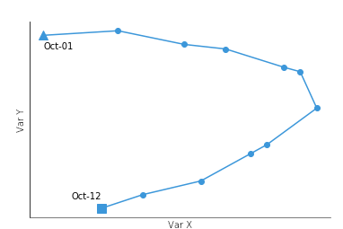
Scatterplot

Slide 29
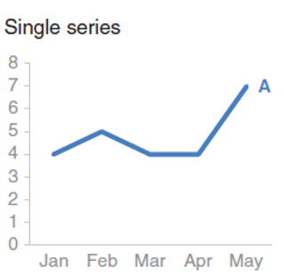
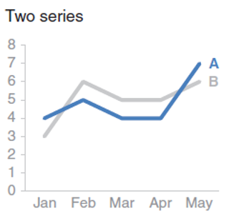
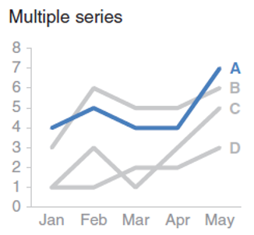
Lines

Slide 30
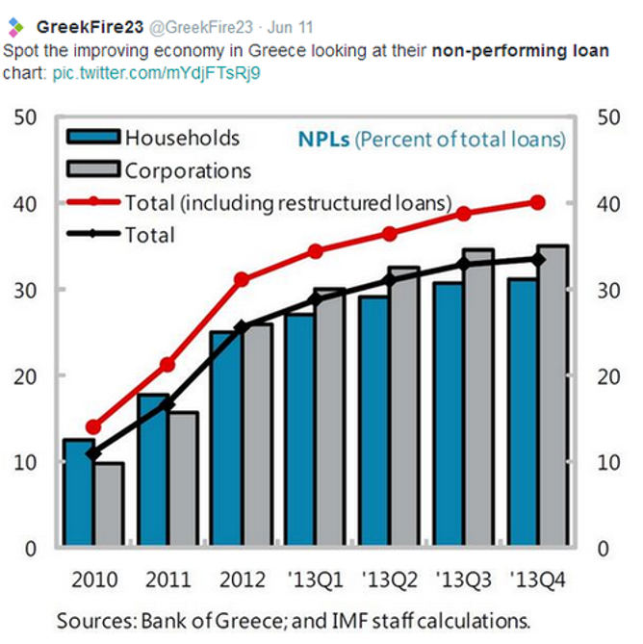

Lines

Slide 31
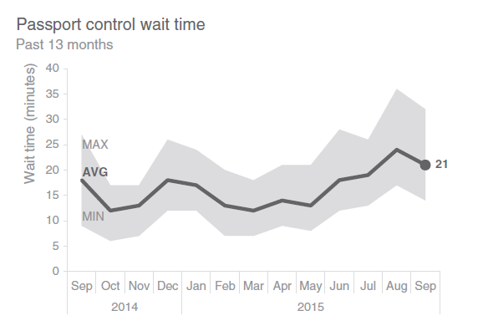
Lines

Slide 32
Area chart

Slide 33
Stacked Area chart

Slide 34
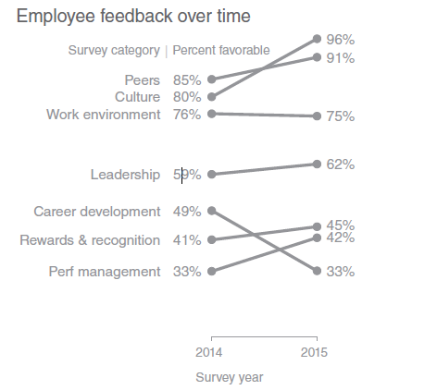
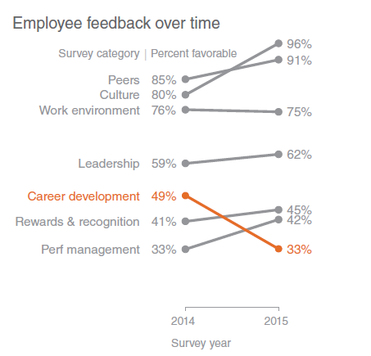
Slope Graph

Slide 35
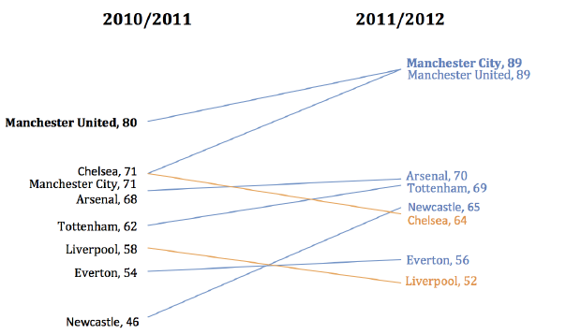
Slope Graph

Slide 36
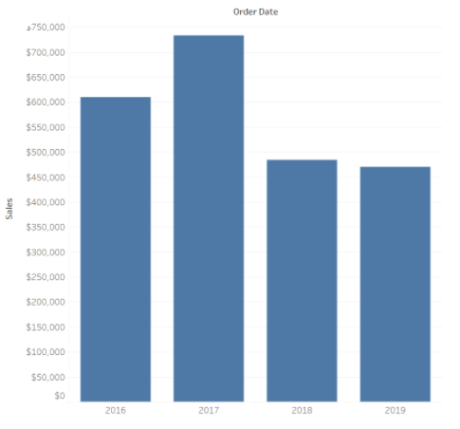
BAR GRAPHS

Slide 37
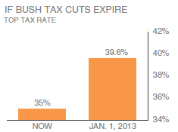
Bars-Non Zero Base line

Slide 38
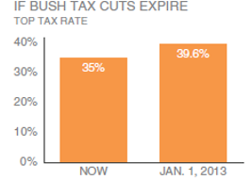
Bars-Zero Base line

Slide 39
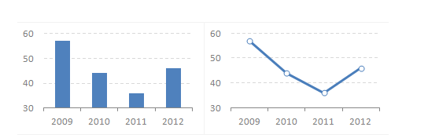
Lines and Bars-Zero Base line -1

Slide 40
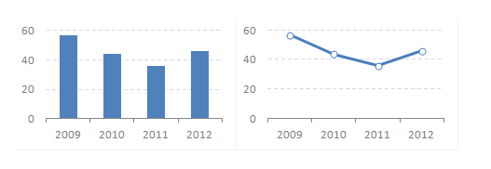
Lines and Bars-Zero Base line-2

Slide 41
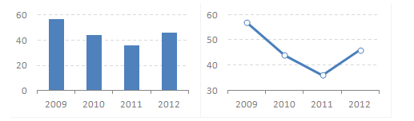
Lines and Bars-Zero Base line-3

Slide 42
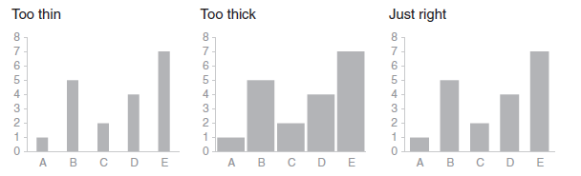
Bars

Slide 43
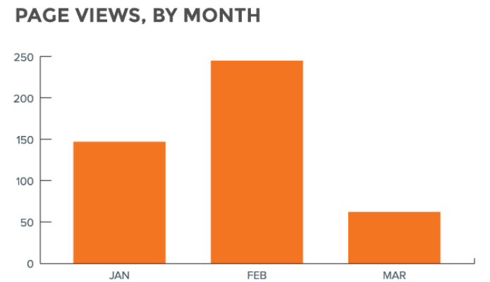
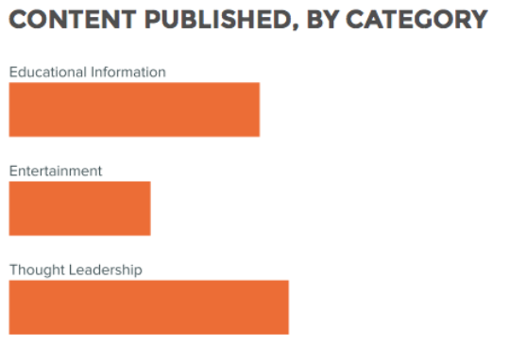
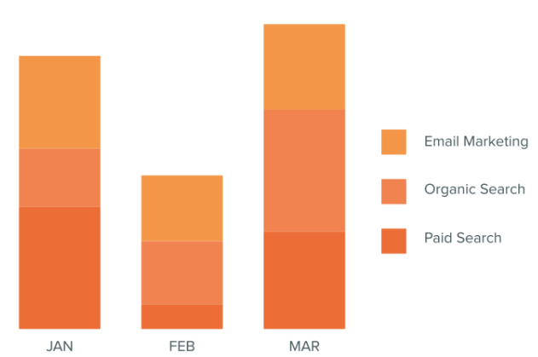
Bars

Slide 44
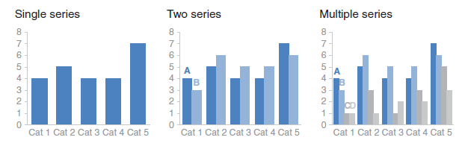
Vertical Bar Charts

Slide 45
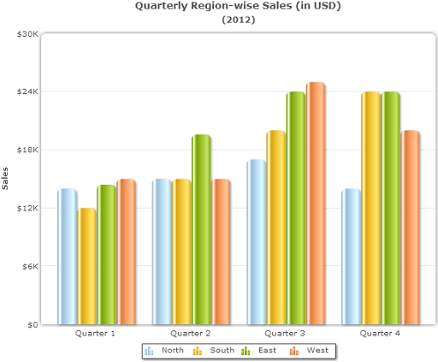
Vertical Bar Charts

Slide 46
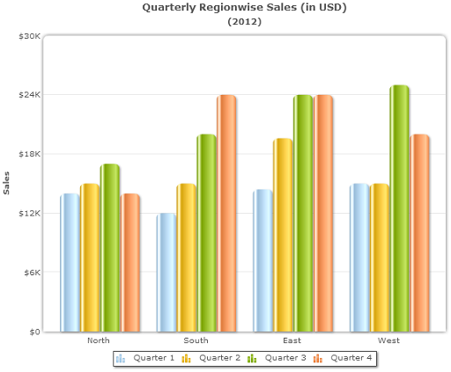
Vertical Bar Charts

Slide 47
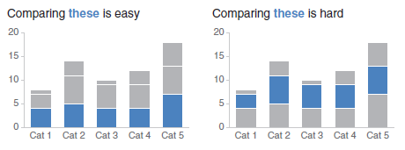
Stacked Vertical Bar Charts

Slide 48
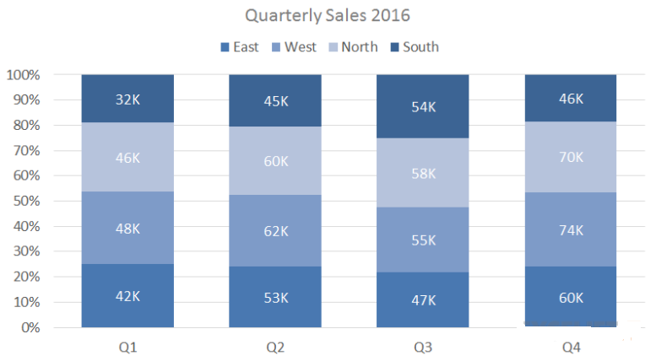
Stacked Vertical Bar Charts

Slide 49
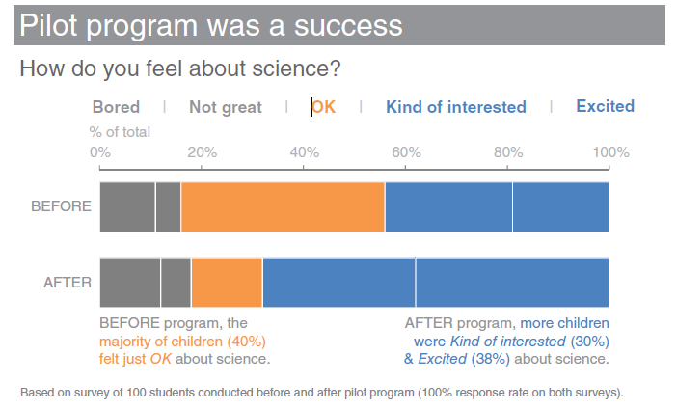
Stacked Bar Charts

Slide 50
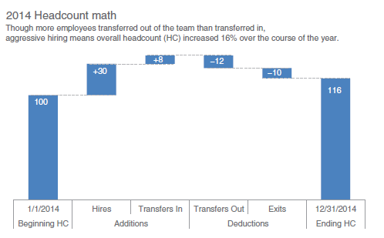
Waterfall chart

Slide 51

Horizontal Bar charts
Logical Order Case Study

Slide 52

Stacked Horizontal Bar charts

Slide 53
Choropleth map

Slide 54


Graphs to be avoided
Pie chart Example

Slide 55

Graphs to be avoided
Pie chart Example (with numbers)

Slide 56

Graphs to be avoided

Slide 57

Graphs to be avoided
Alternative to Pie chart

Slide 58


Graphs to be avoided
3D Chart Example

Slide 59

Graphs to be avoided
Dual Axis chart Example

Slide 60

Graphs to be avoided
Dual Axis chart Alternative

Slide 61

Graphs to be avoided

Slide 62
Alternative to pie chart case study-
Summer Learning Programme-Revisited
You just completed a pilot summer program on science aimed at improving perceptions of the field among 2nd and 3rd grade elementary children. You conducted a survey going into the program and at the end of the program, and want to use this data as evidence of the success of the pilot program in your request for future funding

Slide 63

Alternative to pie chart case study-
Summer Learning Programme-Revisited

Slide 64

Summer Learning Programme-Alternative #1

Slide 65

Summer Learning Programme-Alternative #2

Slide 66

Summer Learning Programme--Alternative #3

Slide 67

Summer Learning Programme-Alternative #4

Slide 68
Case Study 1-New Client Tier Share
Table in the ppt shows the breakdown of new clients by tier for the recent year. Explore the different visuals that can be used for the data

Slide 69

Case Study 2-Discuss in Canvas
The following shows the number of meals served each year as part of a corporate giving program
STEP 1: Apply heat mapping to the second column of values.
STEP 2: Create a bar graph.
STEP 3: Create a line graph.
STEP 4: Which of the visuals you’ve created do you like best? Why?

Slide 70
Visualisation for Data Mining
Univariate Analysis
Continuous variable
Histogram
Box plot
Categorical Variable
Table – Count/Count%
Bar Chart

Slide 71
Visualisation for Data Mining
Bivariate Analysis
Continuous Vs Continuous
Scatter plot
Categorical Vs Categorical
Two way table of count/count%
Stacked column chart
Categorical vs Continuous
Box Plot

Slide 72



Visualisation for Data Mining
Visualizing Outlier
Box plot
Histogram
Scatter plot

Slide 73

Boxplot Analysis
Five-number summary of a distribution
Minimum, Q1, Median, Q3, Maximum
Boxplot
Data is represented with a box
The ends of the box are at the first and third quartiles, i.e., the height of the box is IQR
The median is marked by a line within the box
Whiskers: two lines outside the box extended to Minimum and Maximum
Outliers: points beyond a specified outlier threshold, plotted individually

Slide 74


Histograms

Slide 75

Scatterplot
Determining if there appears to be a relationship, pattern, or trend between two numeric attributes

Slide 76

Table-Count
Two way table showing movie preferences.

Slide 77
Discuss:When to use Log scale in Visualisations?

Slide 78
Self-Reading
T1:
Data Visualisation : A Successful Design Process By Andy Kirk
Chapter 5: Taxonomy of Data Visualization Methods

Slide 79

References
Knaflic, Cole. Storytelling With Data: A Data Visualization Guide for Business Professionals, Wiley, 2015
Chapter 2 : Choosing an effective visual.

Slide 80


Slide 81



Slide 82
Thank You!

